Slide 1
Ethernet Switch

Slide 2
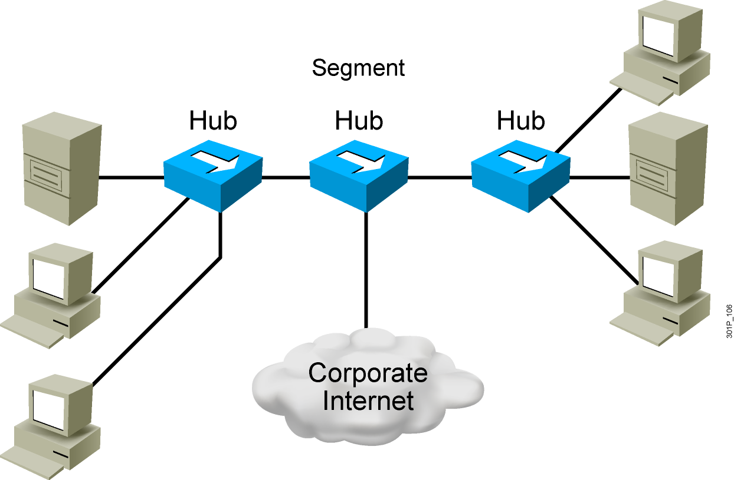
Network Congestion
  High-performance PCs
  More networked data
  Bandwidth-intensive applications
Notes:
Lesson Aim
<Enter lesson aim here.>

Slide 3
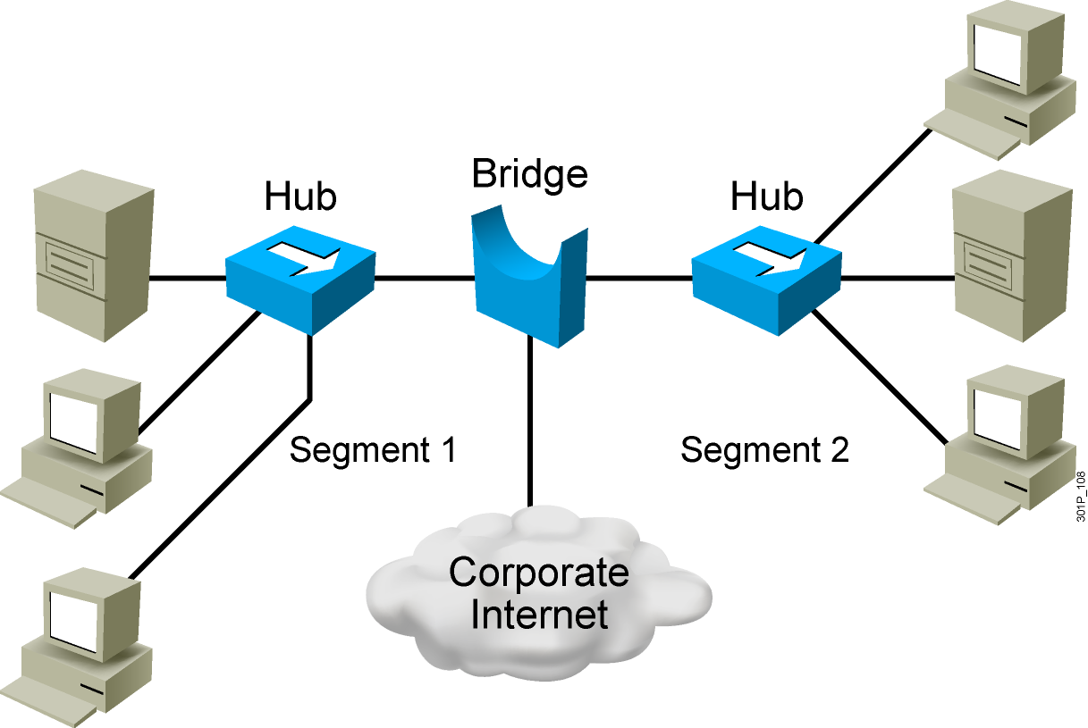
Bridges
  Operate at Layer 2 of the OSI model
  Forward, filter, or flood frames
  Have few ports
  Are slow

Slide 4
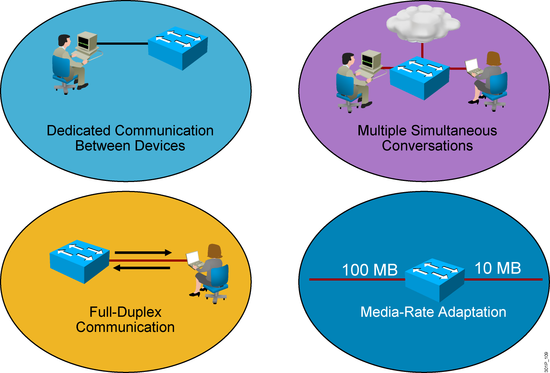
LAN Switch Features
Notes:
Lesson Aim
<Enter lesson aim here.>

Slide 5
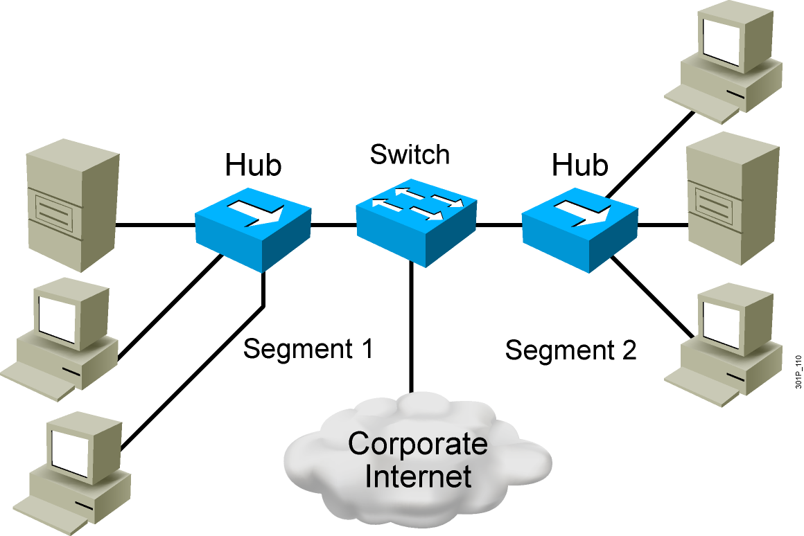
Switches Supersede Bridges
  Operate at Layer 2 of the OSI model
  Forward, filter, or flood frames
  Have many ports
  Are fast

Slide 6
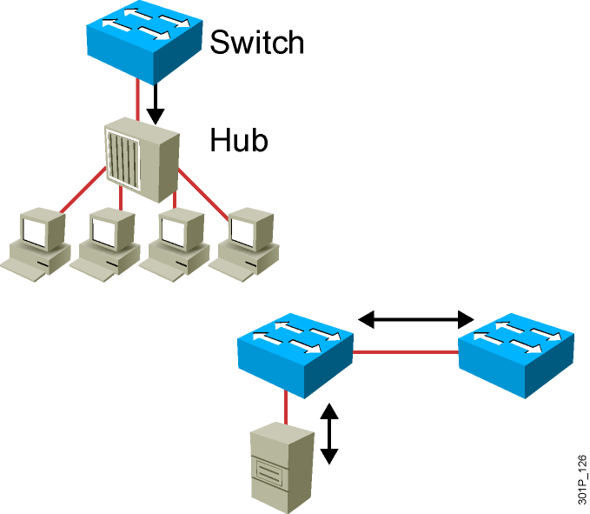
Duplex Overview
Half Duplex (CSMA/CD)
  Unidirectional data flow
  Higher potential for collision
  Hub connectivity
Full Duplex
  Point-to-point only
  Attached to dedicated switched port
  Requires full-duplex support on both ends
  Collision-free
  Collision detect circuit disabled
Notes:
Slide 2 of 2
Emphasize: Full duplex is for point-to-point connections only. A Fast Ethernet full-duplex connection provides a throughput of 200 Mbps (100 Mbps per direction).
Note:

Slide 7
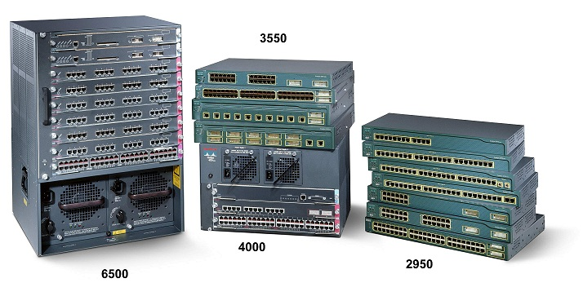
LAN Switch
  High port density
  Large frame buffers
  Mixture of port speeds
  Fast internal switching
  Switching modes:
    Cut-through
    Store-and-forward
    Fragment-free
Notes:
Lesson Aim
<Enter lesson aim here.>

Slide 8
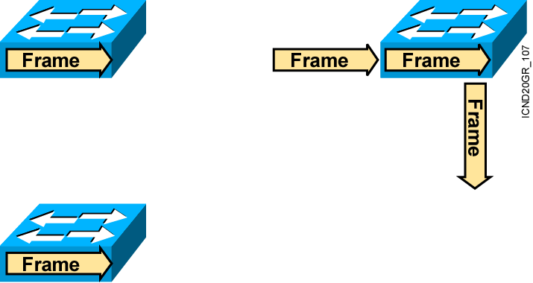
Transmitting Frames
  Cut-Through: Switch checks destination address and immediately begins forwarding frame.
Store and Forward: Complete frame is received and checked before forwarding.
Fragment-Free: Switch checks the first 64 bytes, then immediately begins forwarding frame.
Notes:
64 byte: source MAC: 6 + Dest MAC: 6 + Ethertype: 2 + Data: 46 + FCS: 4

Slide 9
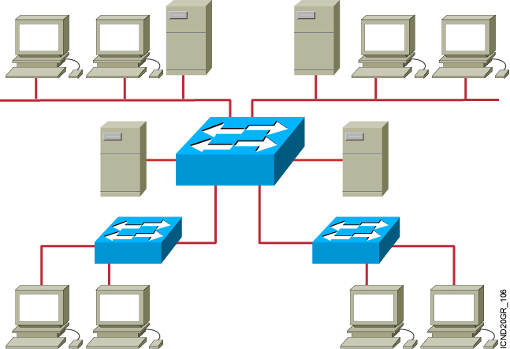
Ethernet Switches and Bridges
  Address learning
  Forward/filter decision
  Loop avoidance

Slide 10
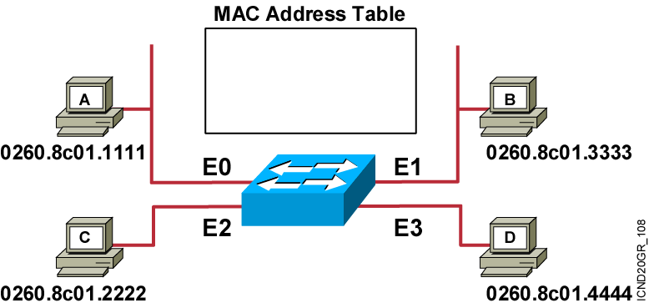
MAC Address Table
Initial MAC address table is empty

Slide 11
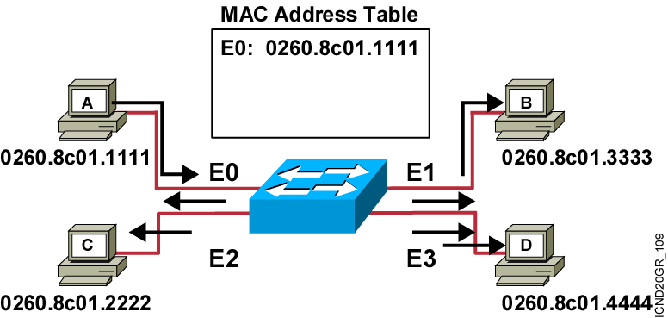
Learning Addresses
Station A sends a frame to station C.
Switch caches the MAC address of station A to port E0 by learning the source address of data frames.
The frame from station A to station C is flooded out to all ports except port E0 (unknown unicasts are flooded).

Slide 12
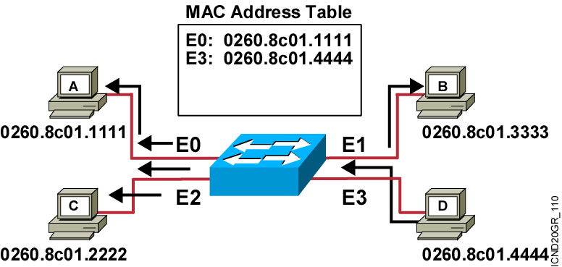
Learning Addresses (Cont.)
Station D sends a frame to station C.
Switch caches the MAC address of station D to port E3 by learning the source address of data frames.
The frame from station D to station C is flooded out to all ports except port E3 (unknown unicasts are flooded).

Slide 13
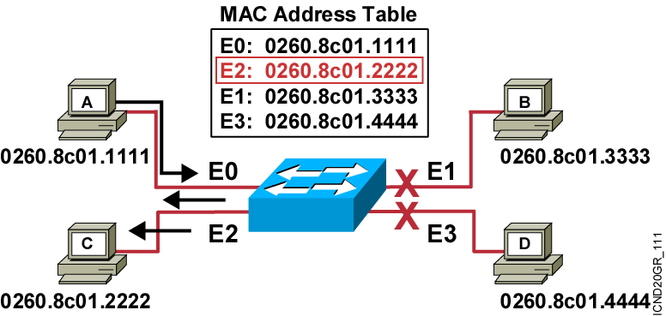
Forward Frames
Station A sends a frame to station C.
Destination is known; frame is not flooded.

Slide 14
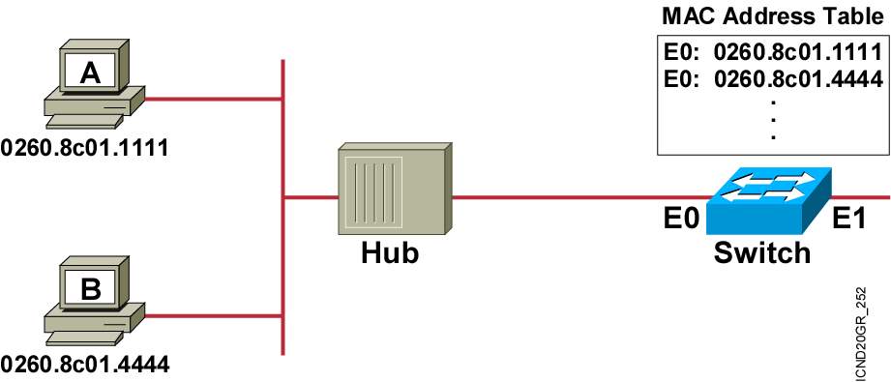
Filtering Frames
Station A sends a frame to station B.
The switch has the address for station B in the MAC address table.

Slide 15
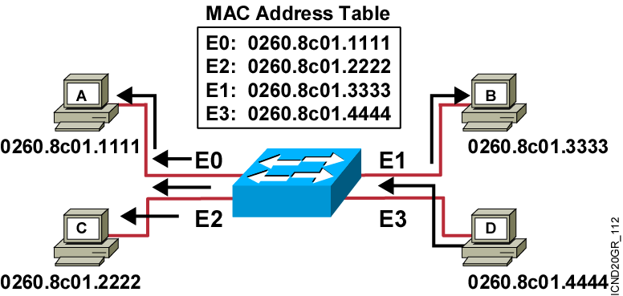
Broadcast and Multicast Frames
Station D sends a broadcast or multicast frame.
Broadcast and multicast frames are flooded to all ports other than the originating port.

Slide 16
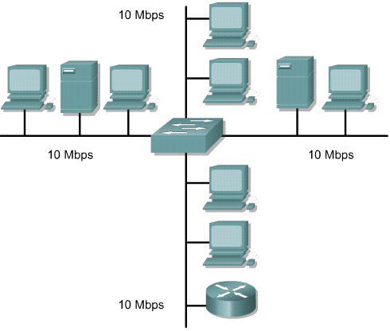
Symmetric switching
A symmetric switch provides switched connections between ports with the same bandwidth.

Slide 17
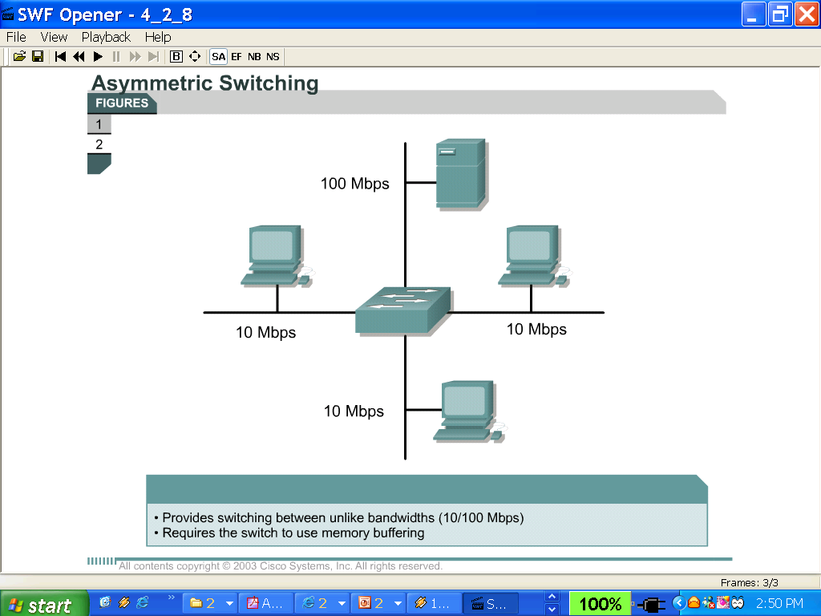
Asymmetric switching
An asymmetric LAN switch provides switched connections between ports of unlike bandwidth, such as a combination of 10 Mbps and 100 Mbps ports.
Asymmetric switching enables more bandwidth to be dedicated to the server switch port in order to prevent a bottleneck.

Slide 18
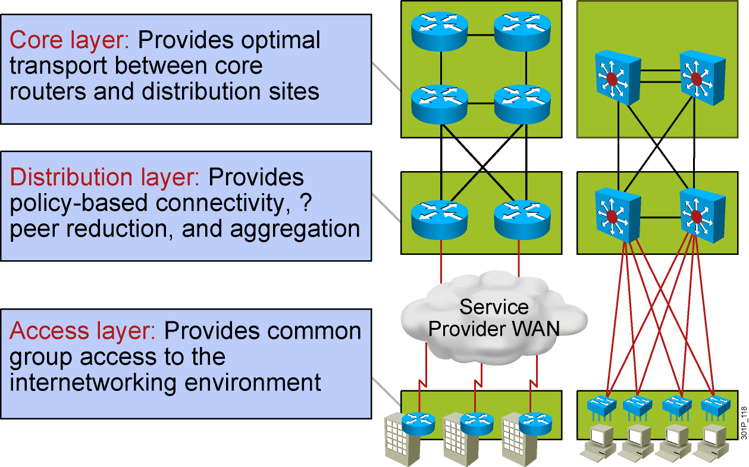
The Hierarchy of Connectivity

Slide 19
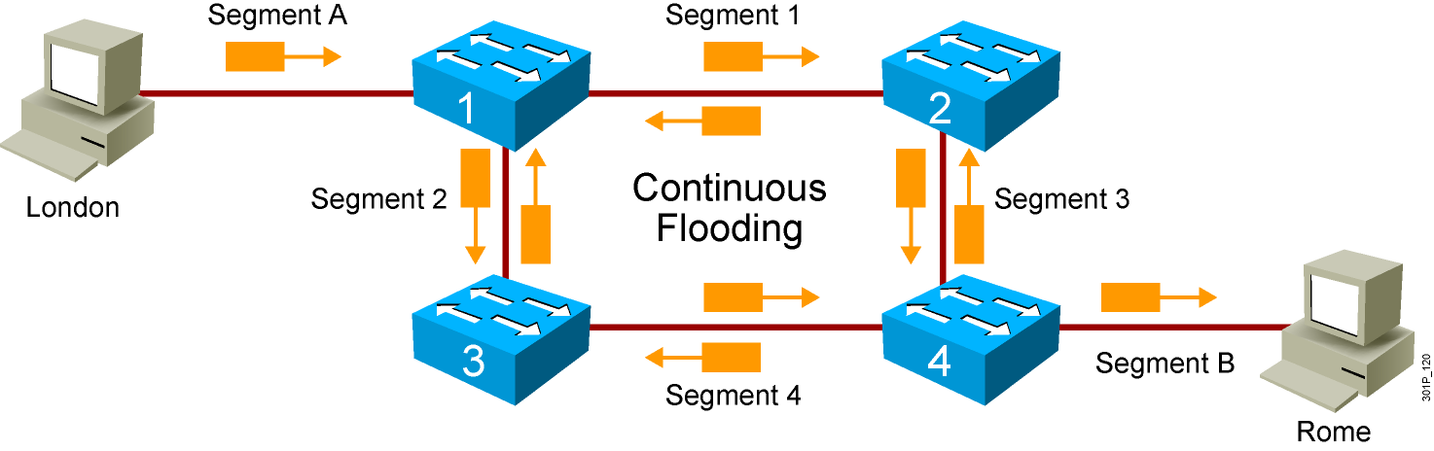
Loops

Slide 20
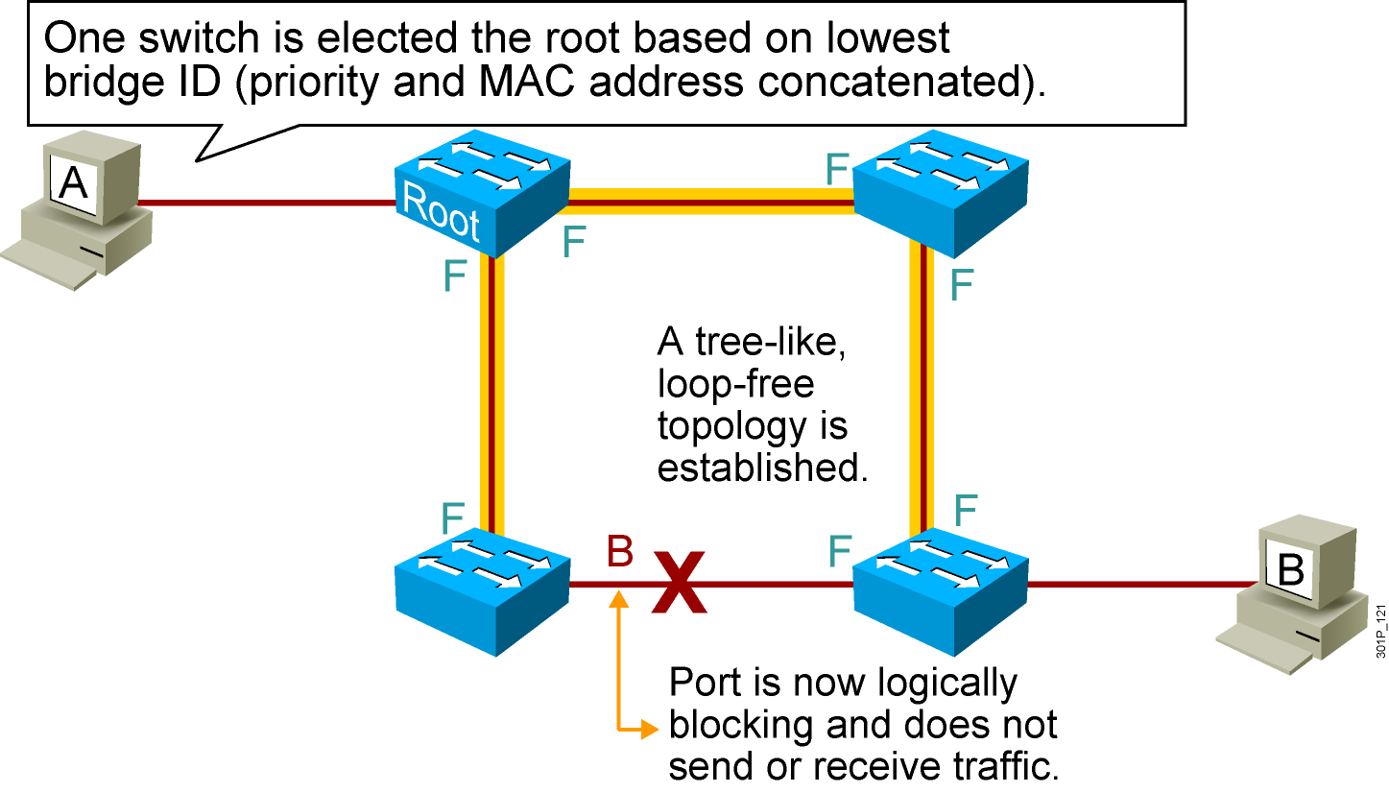
Spanning Tree Protocol

Slide 21
Ethernet LANs
Starting a Switch

Slide 22
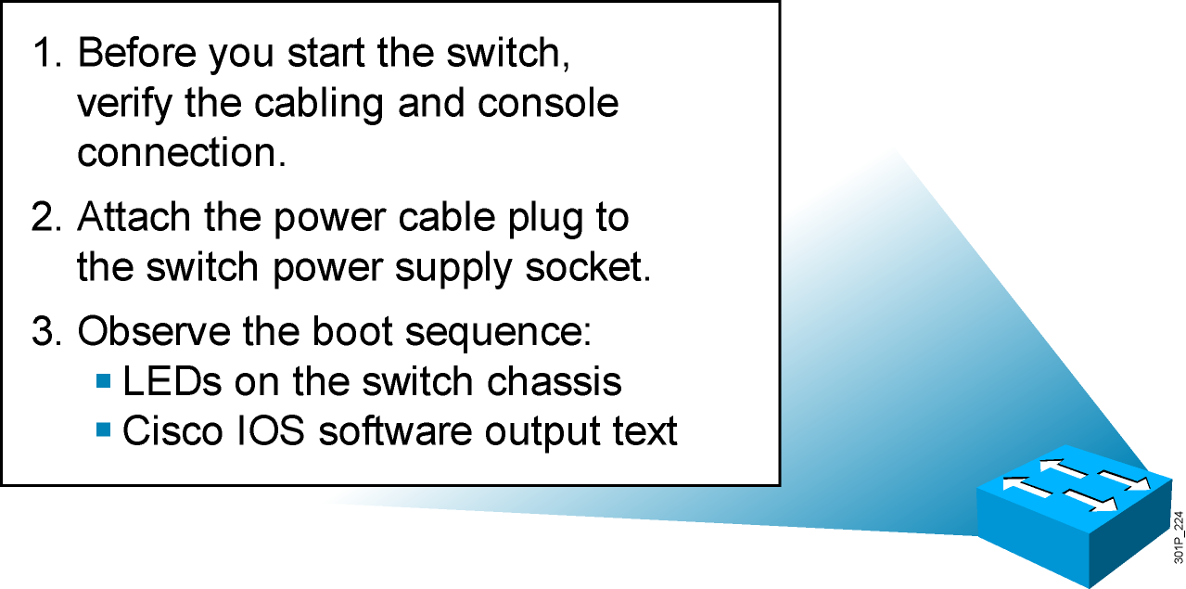
Initial Startup of the Catalyst Switch
  System startup routines initiate switch software.
  Initial startup uses default configuration parameters.
Notes:
Purpose: This slide describes the Catalyst 1900 switch startup procedures.
Emphasize: This slide states the tasks that students will be doing for one of the lab exercises in this module: start the switch, check POST LED display lights, set up required parameters, and check initial configuration messages.
Present this page as a listing of the major activities that your students will learn about in the next several pages, and then practice in the lab.
Item 1 should have been completed with the last chapter. This juncture in the chapter is a good place for you to make sure that these preparations have indeed been done in all the work-groups.
Point out with the item 2 that the Catalyst 1900 switch does not have a power on switch. Plugging in the power cable powers up the switch.
Transition: Use item 3 to transition to the next page for presentation details.

Slide 23
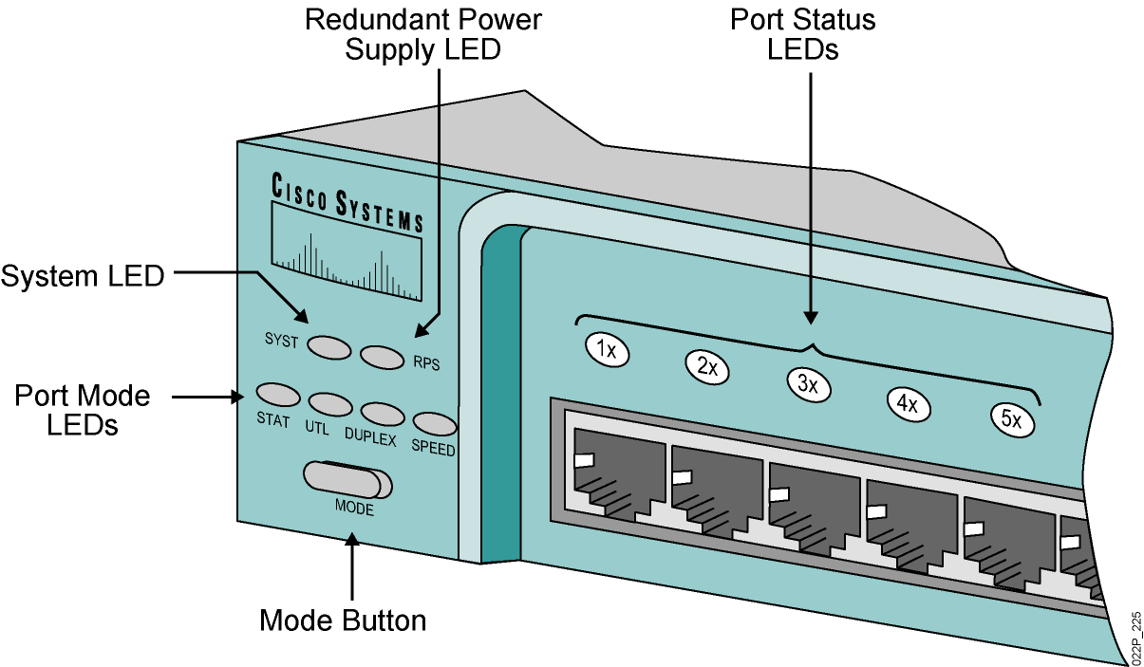
Catalyst 2960 Switch LED Indicators
Notes:
Purpose: This slide describe the LEDs on the Catalyst 1900 switch.
Emphasize: Refer to the table in the Student Guide for presentation details.
Students will not be able to try out the various port LED display modes until they have powered up their switch. Tell your students to put a placeholder on this page so that they can return to it.
Before students can see the three port LED display modes, they will first see the port LEDs indicate a power-on self-test (POST).
Transition: POST indications on the switch port lights.

Slide 24
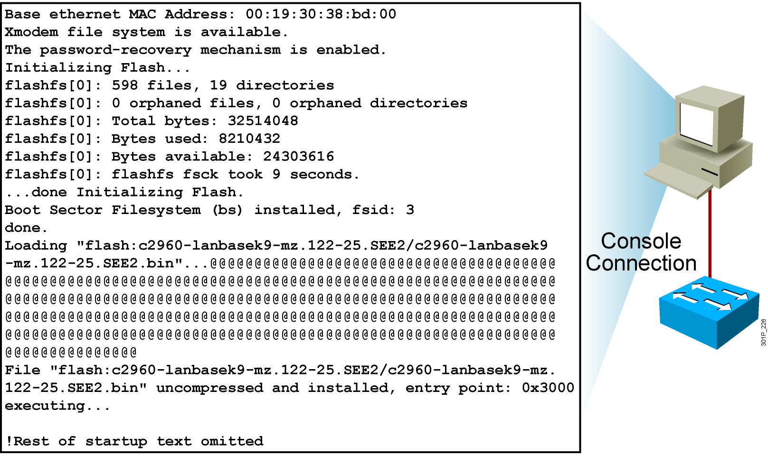
Initial Bootup Output from the Catalyst 2960 Switch
Notes:
Purpose: This slide describes the console output on the Catalyst 1900 switch during startup.
Emphasize: If a POST fails, a corresponding console message will be displayed indicating the POST failure. In this slide, the switch started up without any POST error.
From the User Interface menu, select K to access the command-line interface.
In this class, we will only discuss the Catalyst 1900 CLI configuration method.

Slide 25
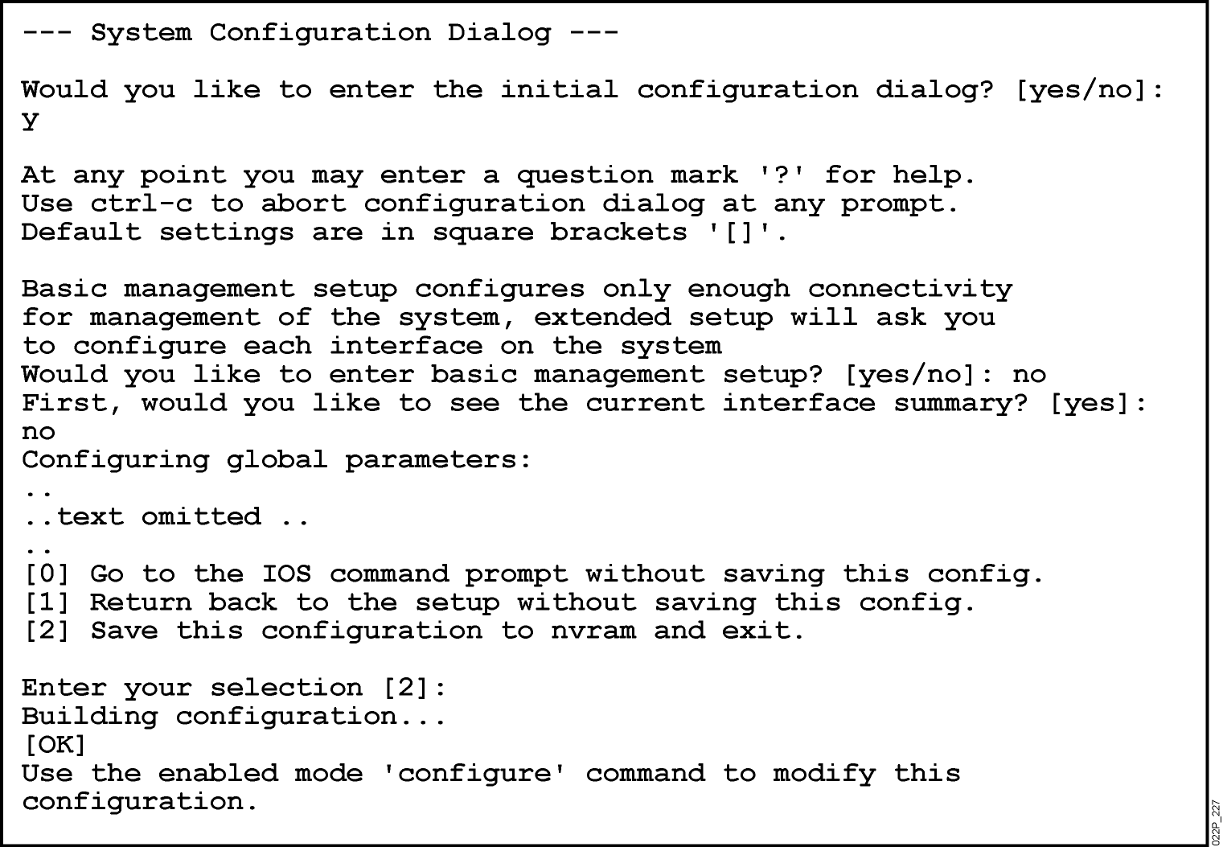
Initial Configuration of the Catalyst 2960 Switch Using Setup
Notes:
Purpose: This slide describes the console output on the Catalyst 1900 switch during startup.
Emphasize: If a POST fails, a corresponding console message will be displayed indicating the POST failure. In this slide, the switch started up without any POST error.
From the User Interface menu, select K to access the command-line interface.
In this class, we will only discuss the Catalyst 1900 CLI configuration method.

Slide 26
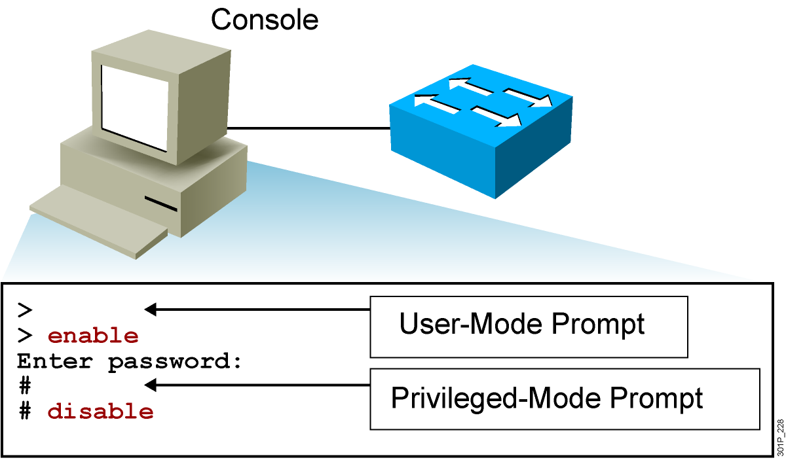
Logging In to the Switch and Entering the Privileged EXEC Mode
Notes:
Purpose: This slide describes logging in the Catalyst 1900 switch.
Emphasize: Earlier you presented an introduction to the two primary EXEC modes with the slides on Cisco IOS user interface fundamentals. Now teach your students about the specifics of the user mode and privileged mode on the Catalyst switch.
Note: The default prompt on the Catalyst 1900 switch is “>” and “#”, without the word “switch” in front of the prompt.
Transition: An overview of the three major types of switch command-line help facilities.

Slide 27

Configuring the Switch
Configuration modes:
  Global configuration mode
    SwitchX#configure terminal
    SwitchX(config)#
  Interface configuration mode
    SwitchX(config)#interface fa0/1
    SwitchX(config-if)#
Notes:
Purpose: This slide describes the configuration modes on the Catalyst 1900 switch.
Emphasize: The Catalyst 1900 Cisco IOS CLI has global and specific configuration modes like the router Cisco IOS CLI.

Slide 28
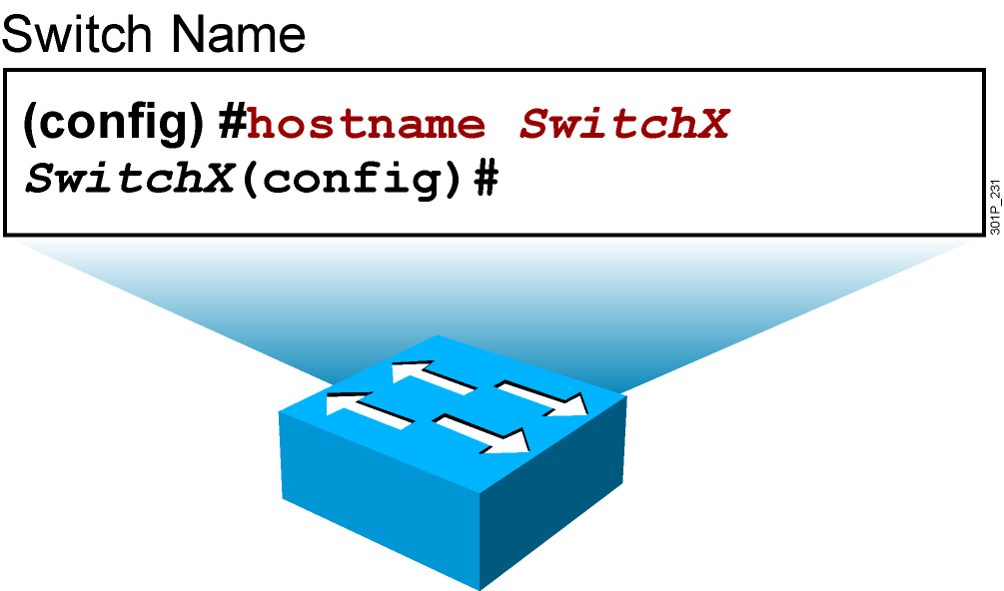
Configuring Switch Identification
Sets the local identity for the switch
Notes:
Purpose: This slide describes configuring the host name on the Catalyst 1900 switch.
Emphasize: To make configuring and maintaining a network easier, several features provide recording and descriptive information in the configuration. The first is the host name, which is simply a name by which this switch is known in the network. When you log in to a switch, the host name is displayed in the prompt. This feature is very convenient when you are remotely configuring switches, because it is a quick reminder of which switch you are accessing.
Note: The Catalyst 1900 switch has no default host name. By default, the global configuration prompt is (config)#.

Slide 29
Configuring the Switch IP Address
SwitchX(config)#interface vlan 1
SwitchX(config-if)#ip address {ip address} {mask}
Example:
SwitchX(config)#interface vlan 1
SwitchX(config-if)#ip address 10.5.5.11 255.255.255.0
SwitchX(config-if)#no shutdown
Note: It is necessary to use the no shutdown command to make the interface operational.
Notes:
Purpose: This slide describes the ip address global configuration command on the Catalyst 1900 switch.
Emphasize: Why does a Layer 2 switch require an IP address? It is used for switch management purposes, for example, to Telnet to the switch, or to use the Web-based Visual Switch Manager to manage the switch.
Note: On the Catalyst 1900 and 2900xl switches, the IP address is always in VLAN1. It cannot be moved to any other VLAN like the Catalyst 5000 SC0 port.

Slide 30
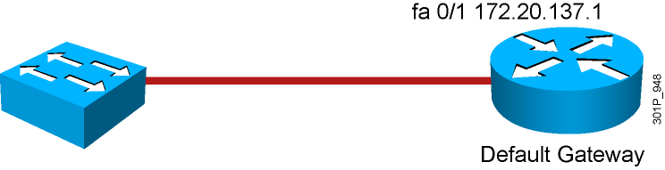
Configuring the Switch Default Gateway
SwitchX(config)#ip default-gateway {ip address}
Example:
SwitchX(config)#ip default-gateway 172.20.137.1
Notes:
Purpose: This slide describes the ip address global configuration command on the Catalyst 1900 switch.
Emphasize: Why does a Layer 2 switch require an IP address? It is used for switch management purposes, for example, to Telnet to the switch, or to use the Web-based Visual Switch Manager to manage the switch.
Note: On the Catalyst 1900 and 2900xl switches, the IP address is always in VLAN1. It cannot be moved to any other VLAN like the Catalyst 5000 SC0 port.

Slide 31
Saving Configurations
SwitchX#
SwitchX#copy running-config startup-config
Destination filename [startup-config]?
Building configuration…
[OK]
SwitchX#
Copies the current configuration to NVRAM
Notes:
Emphasize: Copying to NVRAM overwrites the contents in NVRAM.

Slide 32
Showing Switch Initial Startup Status
SwitchX#show version
  Displays the configuration of the system hardware, software version, names and sources of configuration files, and boot images
SwitchX#show running-config
  Displays the current active configuration file of the switch
SwitchX#show interfaces
  Displays statistics for all interfaces configured on the switch
Notes:
Purpose: This slide describes three basic show commands on the Catalyst 1900 switch.
Emphasize: The next few slides will show the outputs of these show commands.

Slide 33
Switch show version Command
Switch#show version
SOFTWARE (fc1)
Copyright (c) 1986-2006 by Cisco Systems, Inc.
Compiled Fri 28-Jul-06 11:57 by yenanh
Image text-base: 0x00003000, data-base: 0x00BB7944
ROM: Bootstrap program is C2960 boot loader
BOOTLDR: C2960 Boot Loader (C2960-HBOOT-M) Version 12.2(25r)SEE1, RELEASE SOFTWARE (fc1)
System returned to ROM by power-on
System image file is "flash:c2960-lanbasek9-mz.122-25.SEE2/c2960-lanbasek9-mz.122-25.SEE2.bin"
Processor board ID FOC1052W3XC
Last reset from power-on
1 Virtual Ethernet interface
24 FastEthernet interfaces
2 Gigabit Ethernet interfaces
The password-recovery mechanism is enabled.
! Text omitted
Switch#
Cisco IOS Software, C2960 Software (C2960-LANBASEK9-M), Version 12.2(25)SEE2, RELEASE
Switch uptime is 24 minutes
cisco WS-C2960-24TT-L (PowerPC405)processor(revision B0) with 61440K/4088K bytes of memory.
Notes:
Purpose: This slide describes the show version command output on the Catalyst 1924 switch.
The 1924 has 27 fixed ports (24 10BaseT, 1 AUI, 2 100BaseT).
Emphasize: Point out that this command is useful when troubleshooting problems because it gives the versions of the Cisco IOS software. It also displays how long the switch has been in operation.
Note: The MAC address on each port is based on the base Ethernet address. For example, from this slide, the first port (e0/1) on the switch will have a MAC address of 00-50-BD-73-E2-C1.

Slide 34
Switch show interfaces Command
SwitchX#show interfaces FastEthernet0/2
FastEthernet0/2 is up, line protocol is up (connected)
Hardware is Fast Ethernet, address is 0008.a445.ce82 (bia 0008.a445.ce82)
MTU 1500 bytes, BW 10000 Kbit, DLY 1000 usec,
reliability 255/255, txload 1/255, rxload 1/255
Encapsulation ARPA, loopback not set
Keepalive set (10 sec)
Half-duplex, 10Mb/s
input flow-control is unsupported output flow-control is unsupported
ARP type: ARPA, ARP Timeout 04:00:00
Last input 4w6d, output 00:00:01, output hang never
Last clearing of "show interface" counters never
Input queue: 0/75/0/0 (size/max/drops/flushes); Total output drops: 0
Queueing strategy: fifo
Output queue: 0/40 (size/max)
5 minute input rate 0 bits/sec, 0 packets/sec
5 minute output rate 0 bits/sec, 0 packets/sec
182979 packets input, 16802150 bytes, 0 no buffer
Received 49954 broadcasts (0 multicast)
0 runts, 0 giants, 0 throttles
0 input errors, 0 CRC, 0 frame, 0 overrun, 8 ignored
0 watchdog, 20115 multicast, 0 pause input
0 input packets with dribble condition detected
3747473 packets output, 353656347 bytes, 0 underruns
--More--
Hardware is Fast Ethernet, address is 0008.a445.ce82 (bia 0008.a445.ce82)
Half-duplex, 10Mb/s
0 CRC,
Notes:
Purpose: This slide describes the show interfaces command output on the Catalyst 1900 switch.
Emphasize: The top line of the output tells us that the interface is enabled (active state). Other states are disabled (inactive state, must be manually return to the active state), or suspended (inactive state, will automatically return to the enabled state when conditions causing the suspension are removed; for example, a port security violation error can cause a port to go to the suspended state).
Note: The slide only shows the beginning portion of the show interfaces output.

Slide 35
Setting Duplex and Speed Options
Cisco Catalyst 2960 Series
SwitchX(config)#interface fa0/1
SwitchX(config-if)#duplex {auto|full|half}
SwitchX(config-if)#speed {10|100|1000|auto}
Notes:
Emphasize: “Half” is the default on the Ethernet ports.

Slide 36
Managing the MAC Address Table
Catalyst 2960 Series
SwitchX#show mac address-table
Mac Address Table
-------------------------------------------
Vlan Mac Address Type Ports
---- ----------- -------- -----
All 0008.a445.9b40 STATIC CPU
All 0100.0ccc.cccc STATIC CPU
All 0100.0ccc.cccd STATIC CPU
All 0100.0cdd.dddd STATIC CPU
1 0008.e3e8.0440 DYNAMIC Fa0/2
Total Mac Addresses for this criterion: 5
SwitchX#
Notes:
Layer 2 of 2
Note: The 1900en maximum MAC address table size is 1024. Once the table is full, it will flood all new addresses until existing entries age out.
The command to change the MAC address table aging time is as follows:
wg_sw_a(config)#mac-address-table aging-time ?
<10-1000000> Aging time value
The default is 300 sec.
The MAC address table is also referred to as the CAM table (Content Address Memory) on some switches.

